Slide 1
Our goal is to introduce today’s growers to a user-friendly automated wireless irrigation and fertilizer injection system, available on a mobile platform.
The AgRite system offers saving up to 40% in water and 16% in fertilizer and optimizes labor resources, with equal or greater yields.
Why Monitor when you can Control!

Slide 2
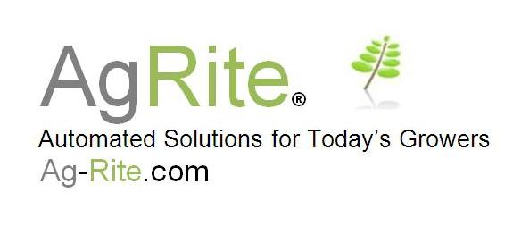
Russel Maridon, Founder, System Integrator,
Hardware design.
Shawn Sherwood, System Integrator, Navy Avionics, System
Programmer.
George Waller, Technical Writer, System Analyst,
MIT Sloan Fellow and BS, Physics from Caltech.

Slide 3
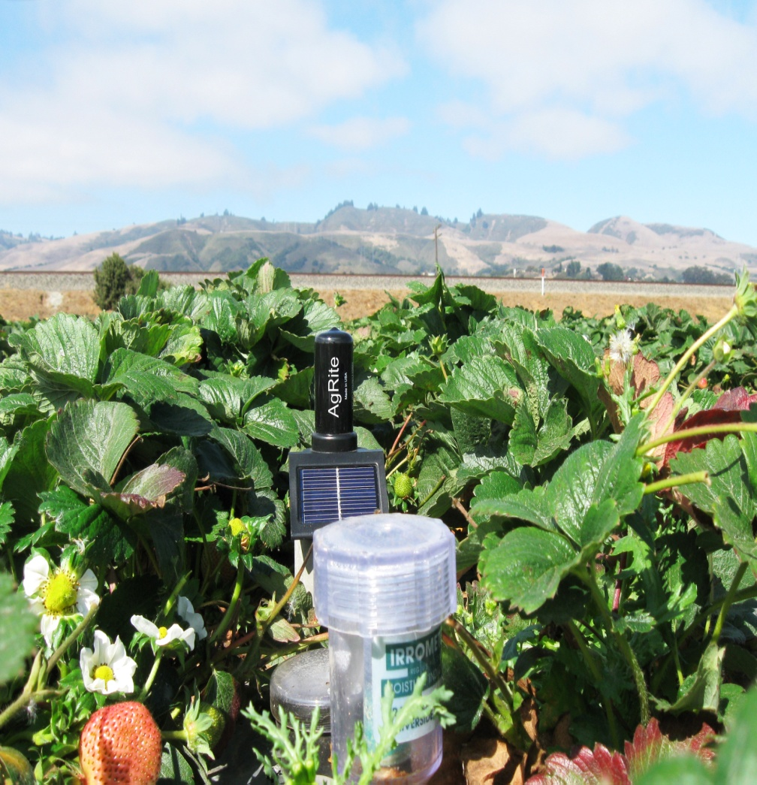
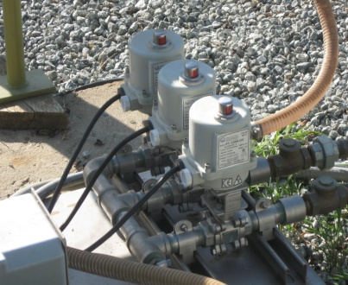
Fertilizer injection system
Remote field sensor

Slide 4
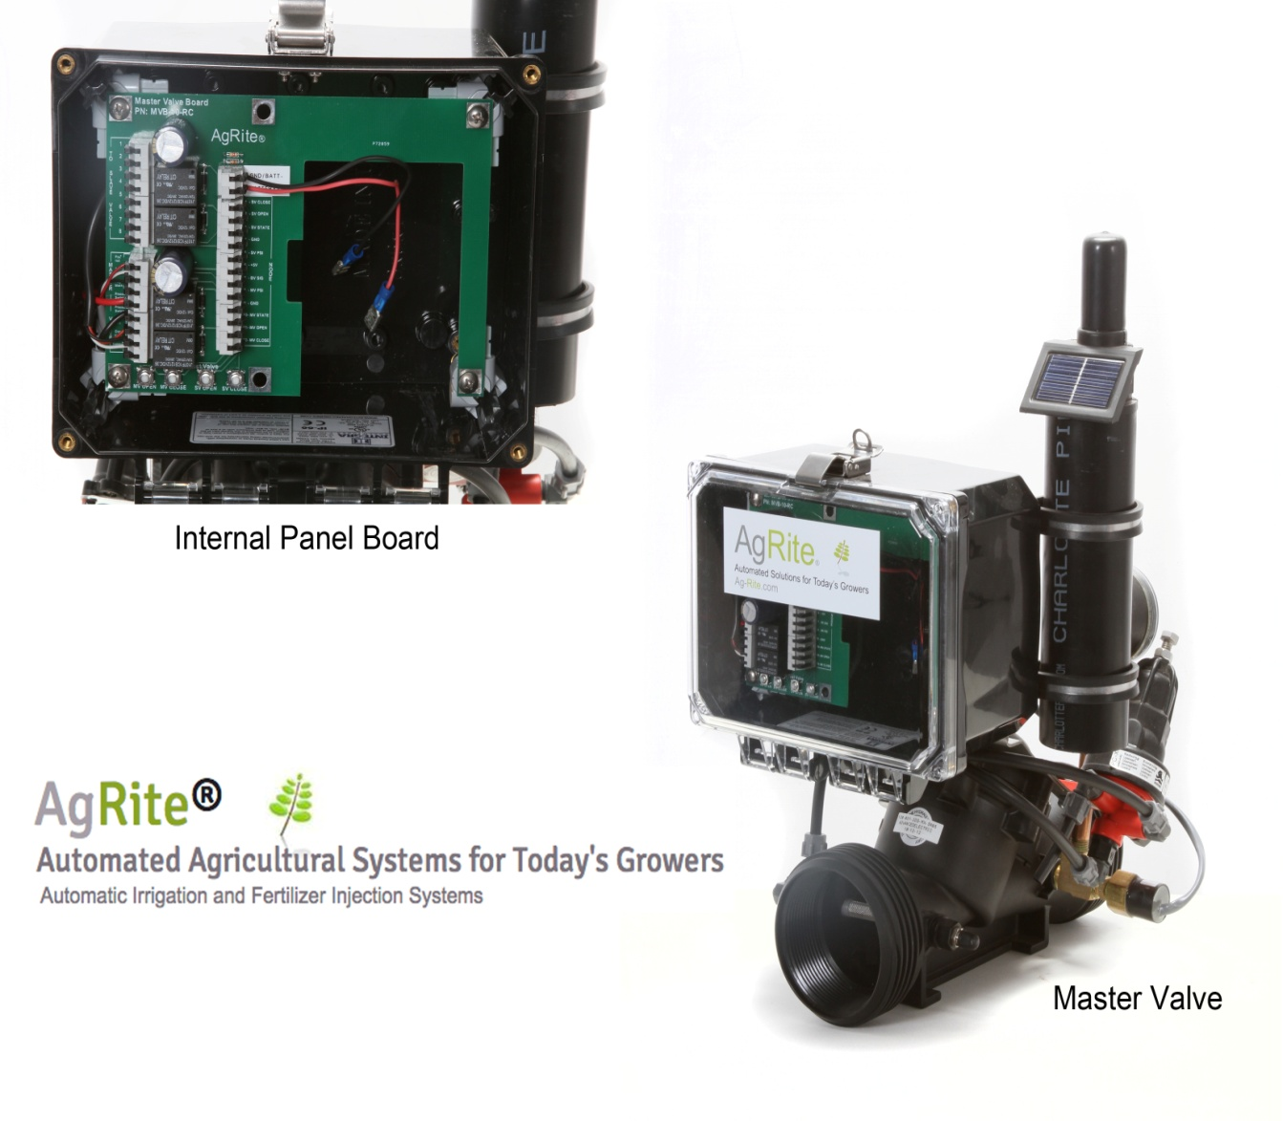
Why Monitor when you can Control!
Wireless controlled Valves.
Solar back up charging, last two days without sunlight.
Up to 2 miles per hop at 2.4 Ghz no license required.
Pressure reducing operation to optimize irrigation.
Manual override with a simple lever.
Easy installation, maintenance and cleaning.

Slide 5
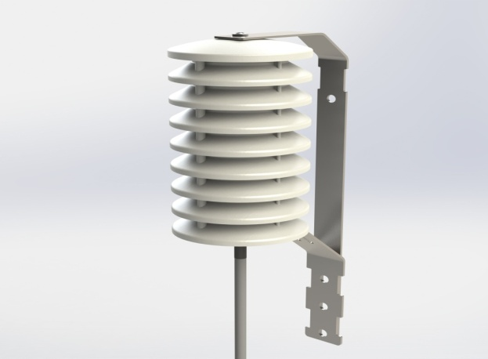
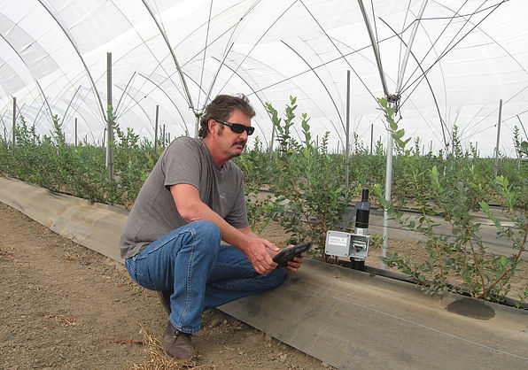
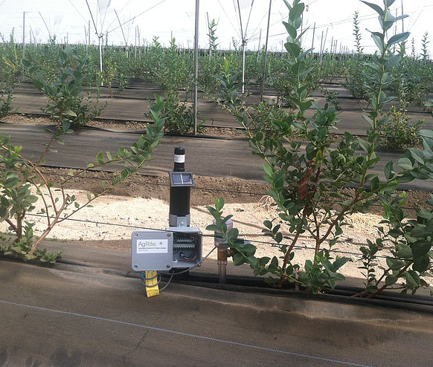
LevelRite Sensor
MeasureRite Temp/Humidity Sensor
Why Monitor when you can Control !

Slide 6
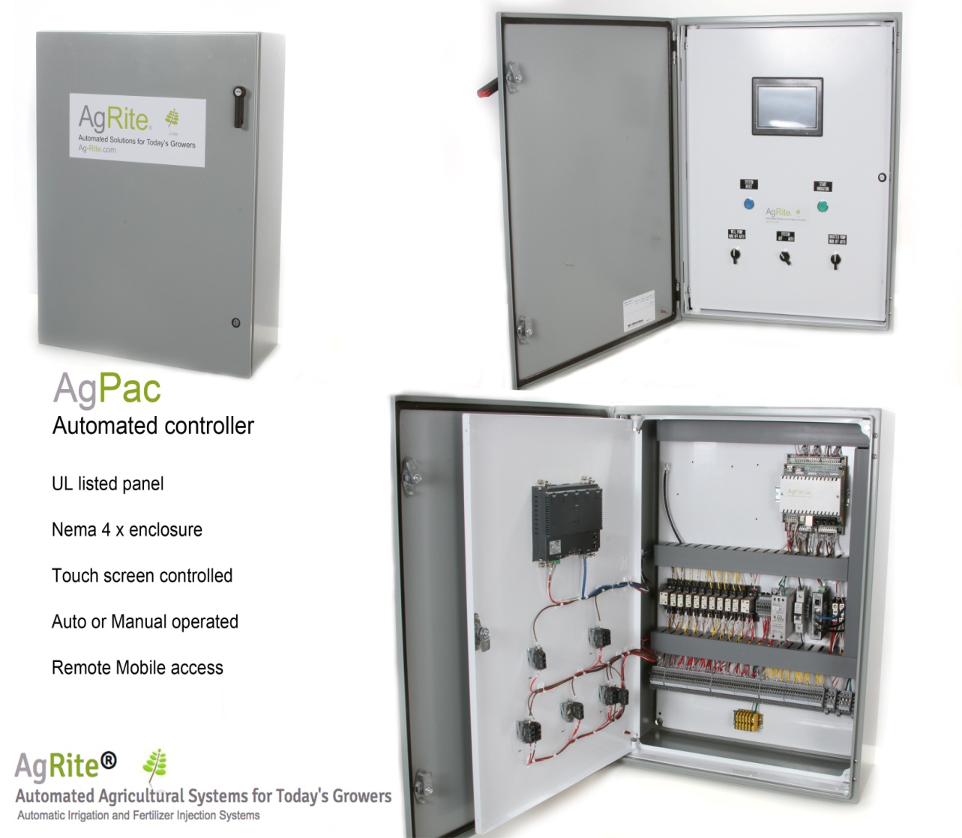
Why Monitor when you can Control!
Designed to meet the rugged demands of the agricultural market.
Includes battery backup.
Sensor based controls with timed base option.
Web access for remote operation
Real time and historical trending.
Custom report generator to assist with production and regulatory needs.

Slide 7
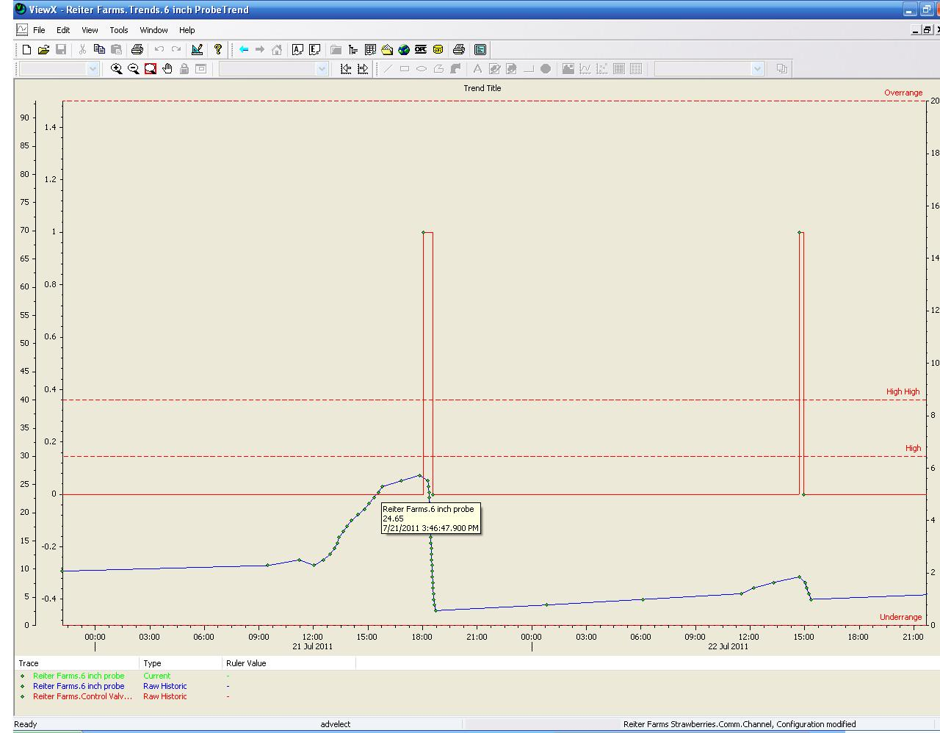
Trends
User selected custom trends
Uses DNP3 advanced historical protocol
Cut and paste to Excel documents

Slide 8
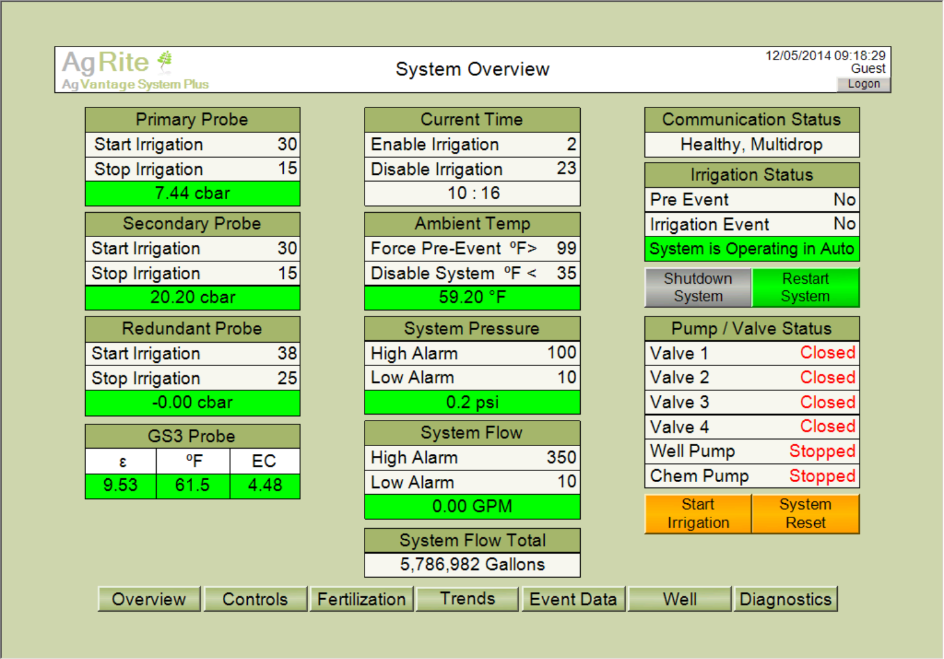
Why Monitor when you can control!
Work with most existing sensors.
Field security options.
Cell or radio base communications.
Thank you for your interest in AgRite® systems

